Slide 1
Loan Approval Decision Support System
Team:
Sabareesh K (2miy0042)
Tamilmani A (22MIY0045)
Kiran surya j (22miy0035)

Slide 2

Problem Statement
Loan approvals are critical financial decisions involving risk assessment.
Current manual loan evaluation methods are:
Time-consuming – checking multiple applicant details by hand.
Prone to errors – human oversight may misjudge applicant credibility.
Subjective – personal bias of officers can influence decisions.
There is a need for an automated, consistent, and data-driven system to evaluate loan applications.

Slide 3
Motivation
Rising number of loan applicants creates pressure on financial institutions.
Machine Learning (ML)-based DSS can:
Speed up loan approval process.
Minimize human errors and bias.
Improve fairness and transparency.
Provide probability-based decisions instead of just binary results.
Outcome: A robust support system that benefits both banks (lower risk) and applicants (fair evaluation).

Slide 4
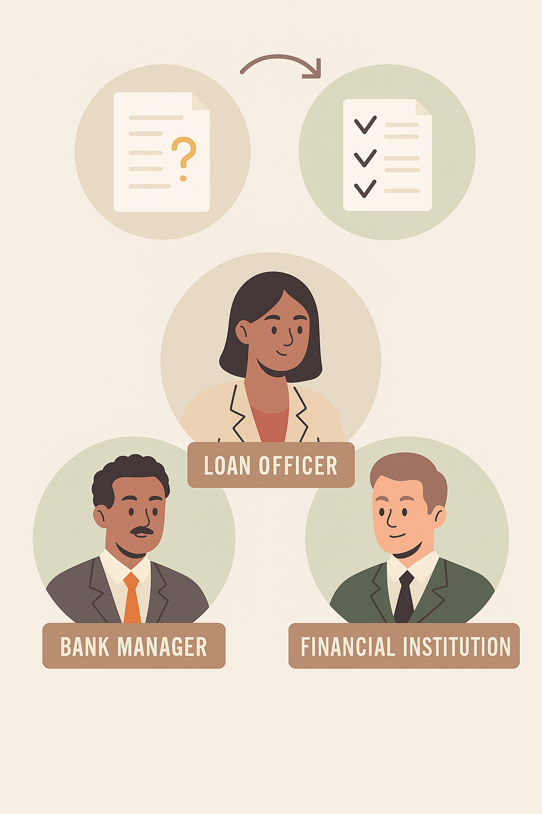
Users & Decisions Supported
Users:
Loan officers
Bank managers
Financial institutions
Decisions Supported:
Whether to approve/reject a loan application
Probability of approval
Key influencing factors for the decision

Slide 5
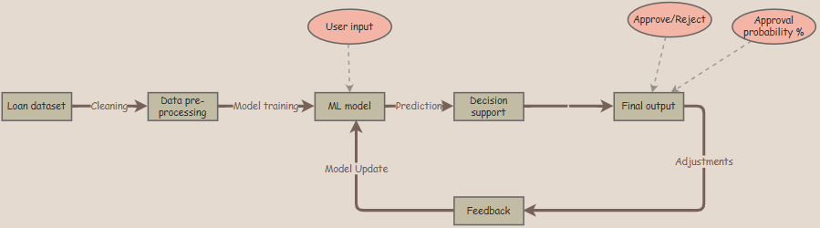
Architecture Sketch

Slide 6
Tools & Technologies
Python – backbone for data preprocessing, feature engineering, and DSS logic.
Pandas & NumPy – used for efficient data cleaning, transformation, and handling numerical operations.
Matplotlib & Seaborn – for visualization of patterns, correlations, and insights.
Scikit-learn – ML library for training and evaluating classification models.
Streamlit – to build an interactive, user-friendly DSS web interface.

Slide 7
Thank You

